Slide 1
H1B VISA DATA ANALYSIS
USING HADOOP FRAMEWORK
Prepared By-
Shivang Mathur
S180020100197
South-Ex (Delhi) Centre

Slide 2

WHAT IS BIG DATA?
Big data is the term for a
collection of data sets so large and complex that it becomes difficult to process using on-hand database management tools or traditional data processing applications.
Example of Big Data:
  The New York Stock Exchange generates about one terabyte of new trade data per day
  Statistic shows that 500+terabytes of new data gets ingested into the databases of social media site Facebook

Slide 3
REASONS WHY BIG DATA IS GENERATING
NEED OF MORE STORAGE CAPABILITIES
INCREASE OF PROCESSING POWER
AVAILABILITY OF DATA (DIFFERENT DATA TYPES)
EVERYDAY WE GENERATE 2.5 QUINTILLIONS OF DATA
90% OF THE DATA TODAY IN THE WORLD HAS BEEN CREATED IN THE LAST 2 YEARS.

Slide 4
APPLICATIONS OF BIG DATA ANALYTICS
Search Quality
Healthcare
Homeland Security
Trading Analytics
_{Banking}
Marketing
Manufacturing

Slide 5
4 V’s OF BID DATA
4 V’s OF BIG DATA
VOLUME
VARIETY
VELOCITY
VARIABILITY
Size of data plays very crucial role in determining value out of data. In Big Data we deal with Large amounts of data.
Variety refers to heterogeneous sources and the nature of data, both structured and unstructured.
velocity refers to the speed of generation of data. How fast the data is generated and processed to meet the demands
This refers to the inconsistency which can be shown by the data at times.

Slide 6

What is Apache Hadoop?
The Apache Hadoop software library is a framework that allows for the distributed processing of large data sets across clusters of computers using simple programming models.
Created by Doug Cutting and Mike Carafella in 2005.
Cutting named the program after his son’s toy elephant.
It is used by companies lie Facebook, Yahoo, Amazon.

Slide 7
The Hadoop Ecosystem
Hadoop Common
Contains Libraries and other modules
HDFS
Hadoop Distributed File System
Hadoop YARN
Yet Another Resource Negotiator
Hadoop MapReduce
A programming model for large scale data processing

Slide 8

HDFS- Hadoop Distributed File System
HDFS is a file system written in Java based on the Google’s GFS
Data files are split into blocks and distributed across the nodes in the cluster
HDFS works best with a smaller number of large files
Files are split into blocks
Blocks are replicated across multiple machines

Slide 9
MAPREDUCE
A method for distributing computation across multiple nodes
Each node processes the data that is stored at that node
Consists of two main phases Map & Reduce.
The Mapper reads data as key/value pairs
Output from the mapper is sorted by key
The reducer Gets a list of all values associated with a key as input and outputs zero or more final key/value pairs

Slide 10
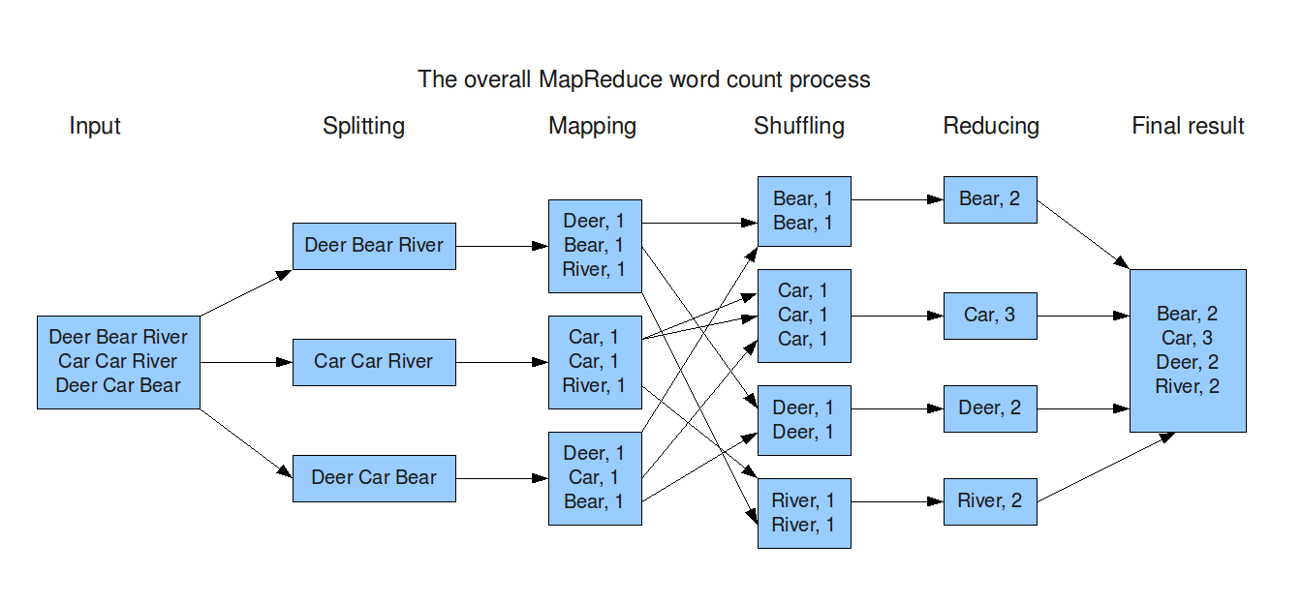
MAPREDUCE : Example

Slide 11
The Mapper
Sort and Shuffle
The Reducer
•Reads data as key/value pairs
• The key is often discarded
•Outputs zero or more key/value pairs
Maps are the individual tasks that transform input records into intermediate records.
Output from the mapper is sorted by key
•All values with the same key are guaranteed to go to the same machine
The shuffle and sort phases occur simultaneously, while map-outputs are being fetched they are merged.
The Reducer code reads the outputs generated by the different mappers as pairs and emits key value pairs.
•The reducer outputs zero or more final key/value pair.

Slide 12
TOOLS IN HADOOP
FRAMEWORK
HIVE
SQOOP
PIG
HBASE
FLUME
OOZIE
ZOOKEEPER

Slide 13


HIVE
Hive is data warehousing framework that's built on Hadoop. It allows for structuring data and querying using a SQL-like language called HiveQL.
Developers can use Hive and HiveQL to write complex MapReduce over structured data in a distributed file system.
PIG
Pig is an application for transforming large data sets.
Like Hive, Pig has its own SQL-Like language called Pig Latin. Where Hive is used for structured data, Pig excels in transforming semi-structured and unstructured data.

Slide 14

FLUME
Flume is a distributed service that helps collect, aggregate and move around large log data. It's written in Java and typically delivers files directly into HDFS.
SQOOP
Sqoop allows developers to transfer data from a relational database into Hadoop.
Zookeeper
Zookeeper provides centralized services for Hadoop cluster configuration management, synchronization and group services.

Slide 15
HBASE
Hadoop runs processes in batch and doesn't allow for modification, and this is what makes HBase so popular.
HBase provides the capability to modify data in real-time and still run in a HDFS environment.
Spark
A real-time general engine for data processing, Spark boasts a speed 100-times faster than Hadoop and works in memory.
Spark supports Scala, Python and Java.

Slide 16
THANKYOU

